Slide 1
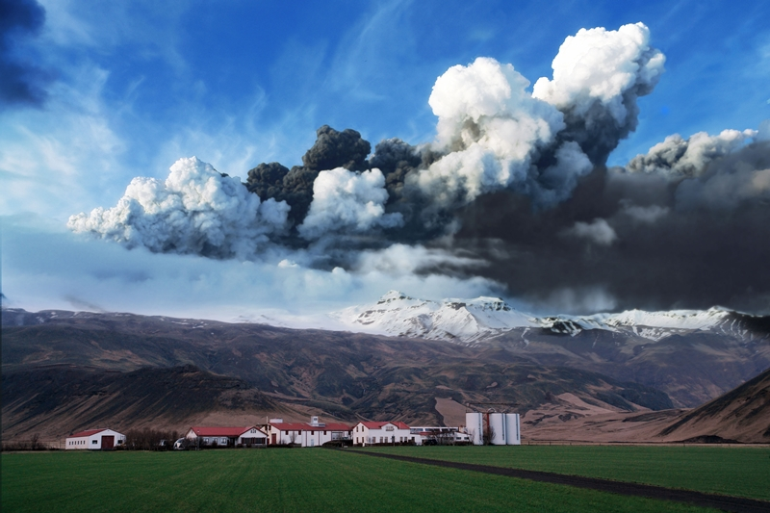
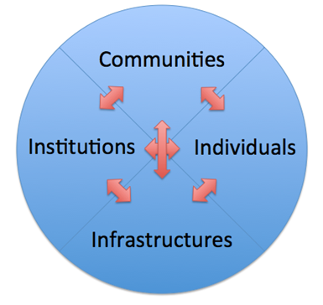
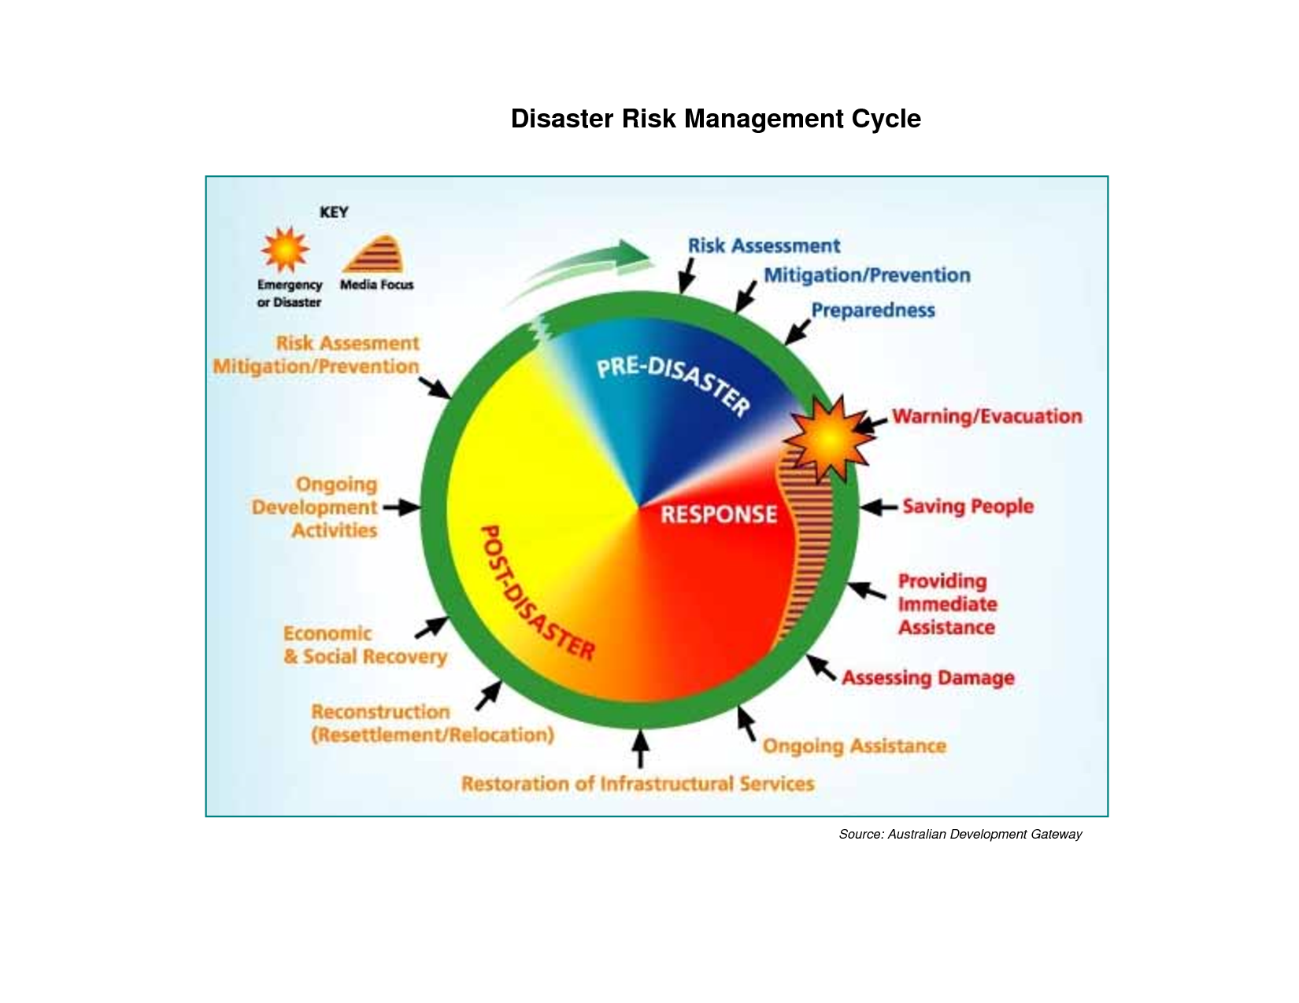
NORDRESS
Nordic Centre of Excellence on Resilience and Societal Security
Institute for Sustainability Studies
University of Iceland
NORDIC CENTER OF EXCELLENCE
THE RESEARCH
NORDRESS is divided into 6 workpackages that are further subdivided into research projects. . For the purpose of analyzing, we view societal resilience as being composed of four dimensions. Individuals contribute to society’s robustness with strong physical and mental health and personal preparedness, while active communities unfold the potential of people working together informally to cope with the impacts of natural hazards on everyday life. Society is bound together by infrastructures that strengthen the overall societal resilience through communication, transportation, critical lifelines, energy, and logistics. In return, these infrastructures support the workings of institutions that create formal frameworks for legal and political responsibility.
NORDRESS is a Centre of Excellence under the Social Security Programme of NordForsk. It is a 5 year operation, 2015-2019, that will carry out multidisciplinary studies to enhance societal security and resilience to natural disasters. Partners from 15 institutions in all Nordic countries join forces to increase the resilience of individuals, communities, infrastructure and institutions.
SOCIETAL RESILIENCE
NORDRESS sets out to work with the concept of “Nordic Societal Resilience”, capitalizing on the strengths of these societies, while looking for ways to develop their resilience further. Ways of increasing societal resilience include the transfer of knowledge and expertise and the search for new solutions to an increasing variety of threats that these societies face. In terms of disasters caused by natural hazards, resilience must permeate the entire cycle of emergency management: prevention, preparedness, response and recovery.
TRAINING AND MOBILITY
NORDRESS strongly supports education, training and mobility through the Nordic Societal Security Academy (NSSA). As the main educational and researcher mobility vehicle of NORDRESS, NSSA provides mobility grants and funds courses or seminars for graduate students, policy makers, rescue workers, media, and others.
WP MANAGERS
Adriaan Perrels , Arna Hauksdóttir, Ask Elklit, Atle Dyregrov, Christian Jaedicke, Farrokh Nadim, Guðmundur Freyr Úlfarsson, Guðný Björk Eydal, Guðrún Gísladóttir, Guðrún Pétursdóttir, Haakon Lein, Hans Jörgen Henriksen, Morten Thanning Vendelø and Per Danielsson.
Links
www.nordress.hi.is
nordress@hi.is

