Slide 1
Risk assessment and prevention of flooding and coastal erosion in extreme weather

Slide 2
Risk assessment and prevention of flooding and coastal erosion in extreme weather
What is WP5.3 about
and
what has been accomplished ?

Slide 3
What is the WP about?
The problem:
Extreme weather events cause floods and coastal erosion, which may have severe consequences for people and infrastructure.
Climate change impacts will mutate current risks and create new ones.
These risks have to be estimated and communicated

Slide 4
What is the WP about?
The task:
Examine hazards and estimate risk for different types of flooding and coastal erosion
Build analysis tools and perform case studies
Develop methods to communicate results

Slide 5
Examples to focus on
Coastal erosion
Coastal flooding in an urban setting
Storm surge risk and sea level rise

Slide 6
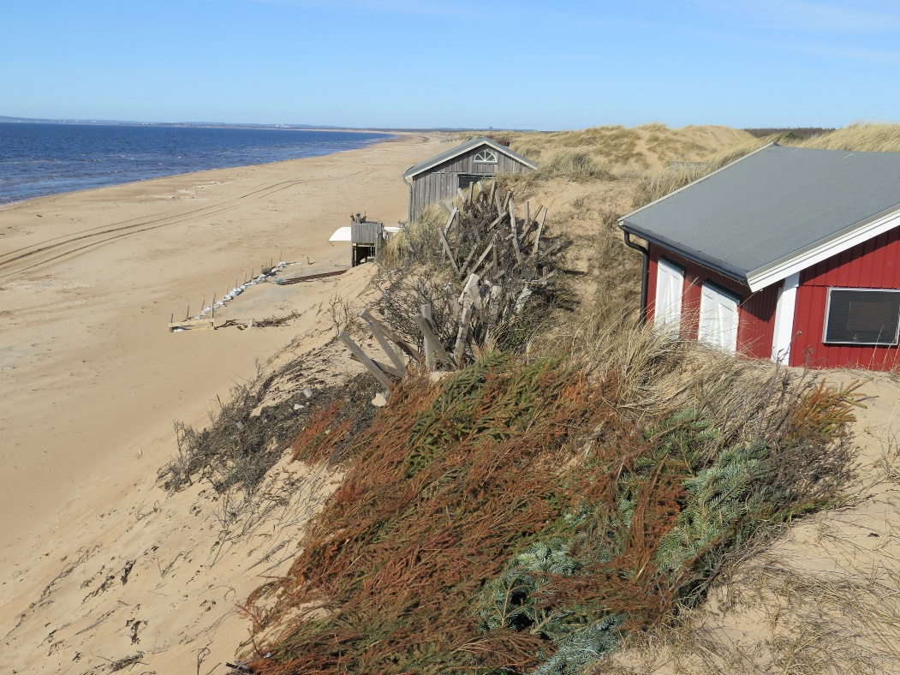
Coastal erosion and sea level rise in Sweden
Problem I: Sea level rise, increasing severity and frequency of coastal storms. Increased coastal erosion
Problem II: Increased plans for socio-economic development in vulnerable areas
Problem III: Difficulties in communicating and interpreting risk and vulnerability analyses to policymakers
Problem IV: How to map “soft” values and perceptions?

Slide 7
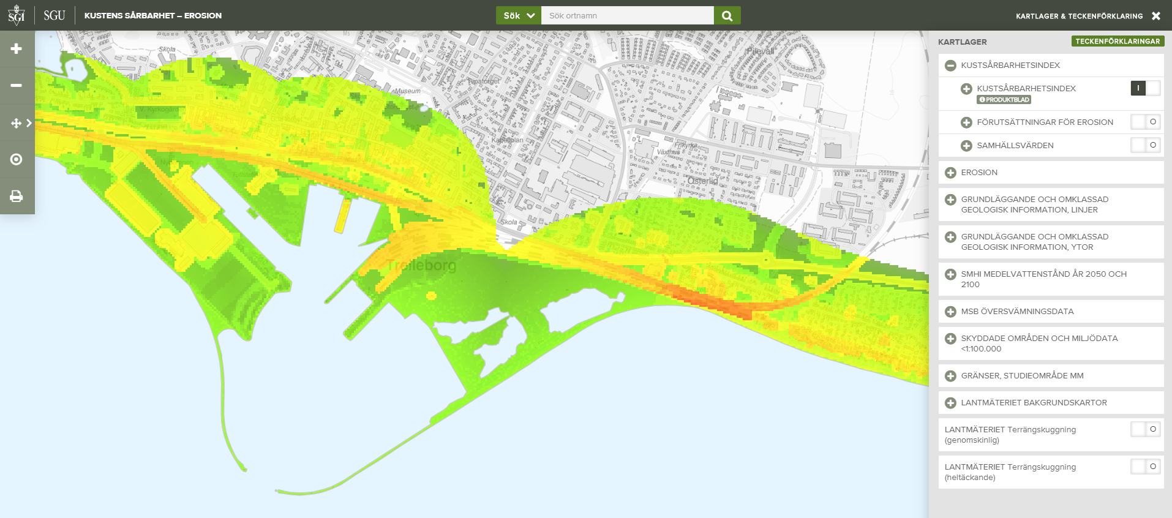
Trelleborg, CVI

Slide 8
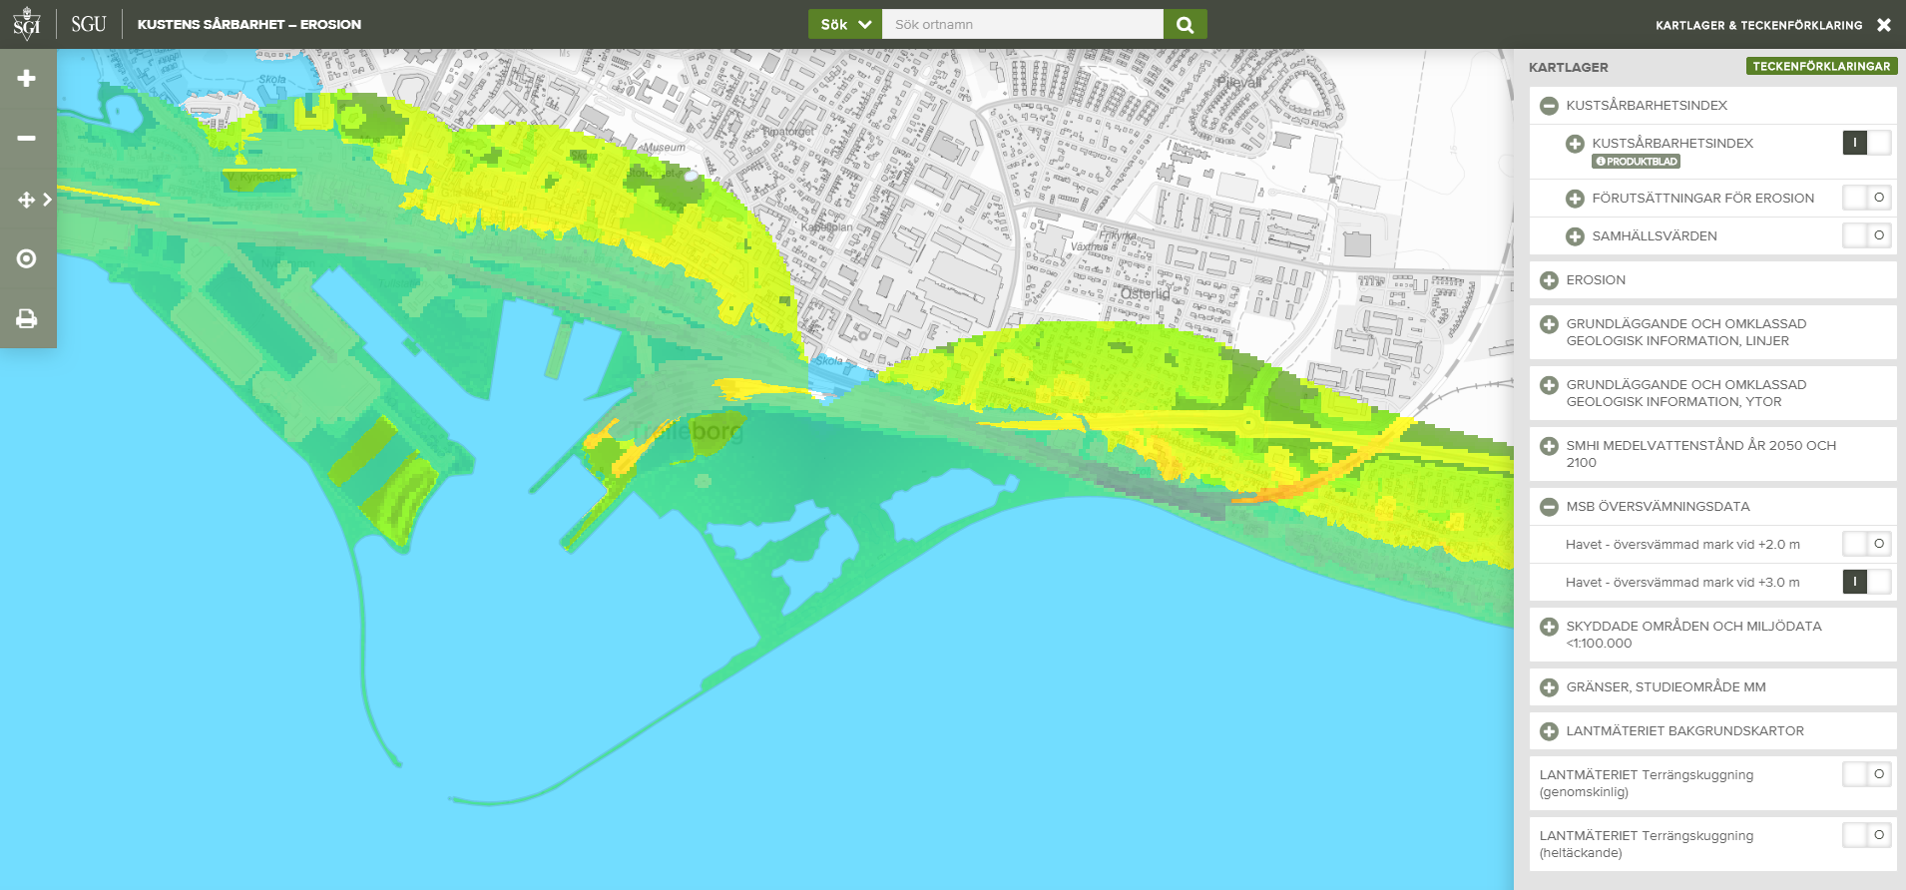
Trelleborg, CVI, +3m sea level

Slide 9
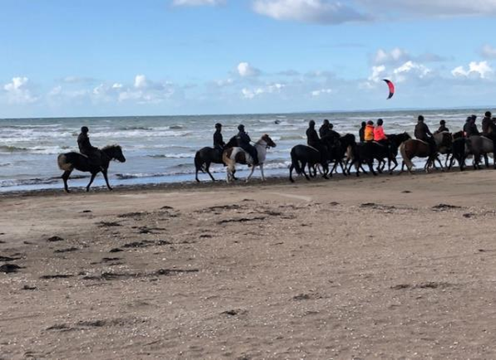
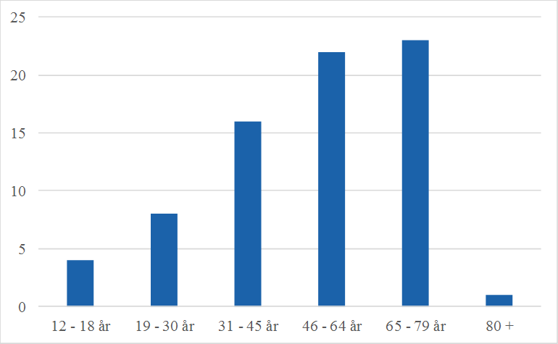
Total 70 interviews
Trelleborg (16-17 August) = 19
Halmstad (14 Sept) = 19
Laholmsbukten (15 Sept) = 17
Båstad (16 Sept) = 16
Understanding perceptions and values – on the beaches of Halland and Skåne…

Slide 10
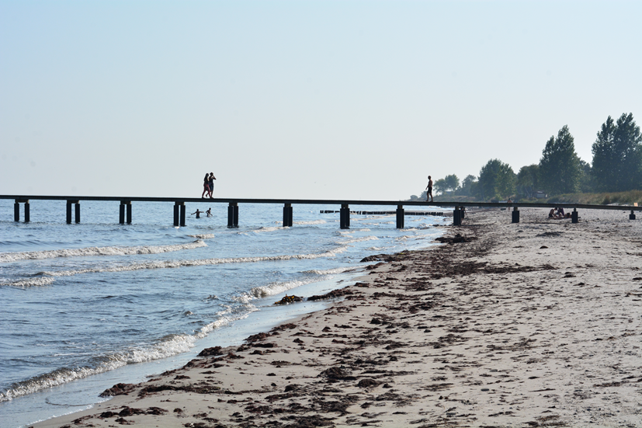
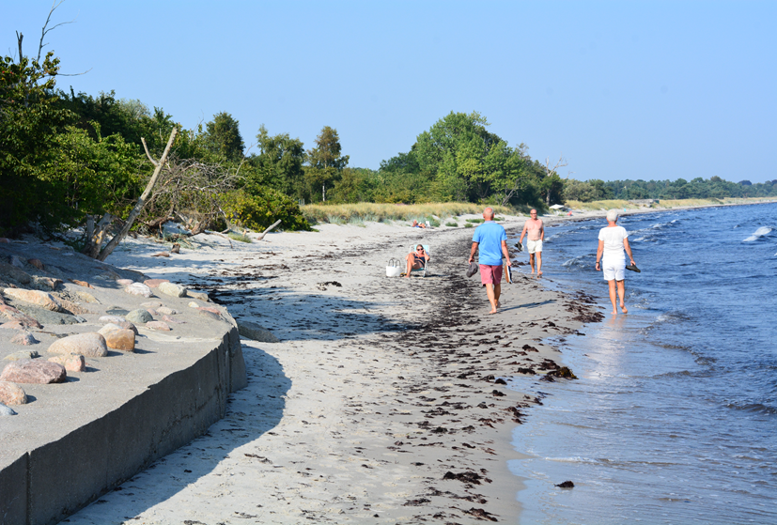
“We are at risk here, but only if the sea level rises more than one meter. We can always move the houses, but we can’t reconstruct this special nature on the beach. I’d like my children and grandchildren to be able to experience this beach the way I have done since childhood” (Middle-aged woman in Laholm)
“Yes, there is a risk, but I won’t be here in 20 years so I’m not worried. Just enjoy the day today” (Retiree in Båstad)
” I’m shocked when I start to think about what might happen in this area in 20 years, if we already see a problem today. The municipality should focus more on this problem. But it’s a class questions, isn’t it? Rich people build big expensive houses close to the water and expect the municipality to pay for coastal defences to protect it. That doesn’t seem right” (Young woman in Halmstad)
“I don’t believe in climate change or sea level rise” (Young man in Laholm)

Slide 11
What do you feel is most worth protecting from SLR?
Citizens
Authorities
Data from interviews in Trelleborg, Halmstad, Laholm, Båstad, August- September. 70 responses
Data from mentimeter voting at Coastal Conference, 13 September. 67 responses

Slide 12
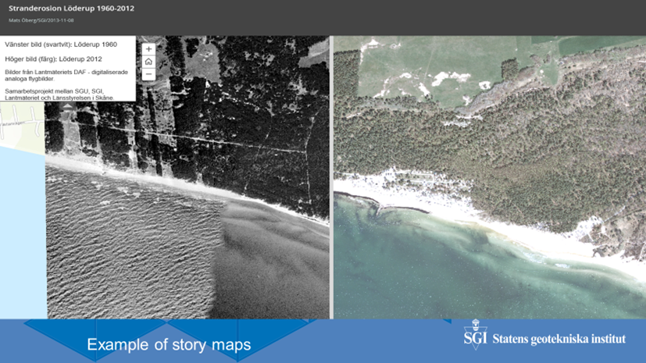

Slide 13
Flooding in an urban setting
Work for higher resilience and sustainability implies a mapping of important characteristics of drivers in order to estimate benefits and potential damage costs
In relation to flooding it is important to incorporate place, water balance and catchment specific knowledge about all thinkable needs and potential hazards
Risk mapping (infrastructure resilience) must consider climate changes, unstable subsurface, abstraction, land use, drainage & institutional aspects of resilience.

Slide 14
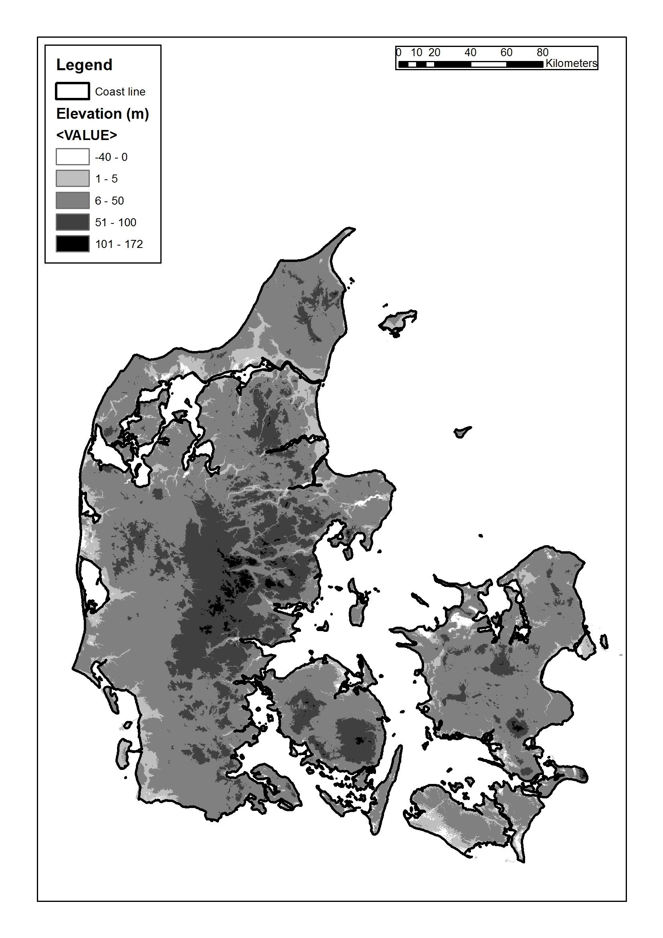
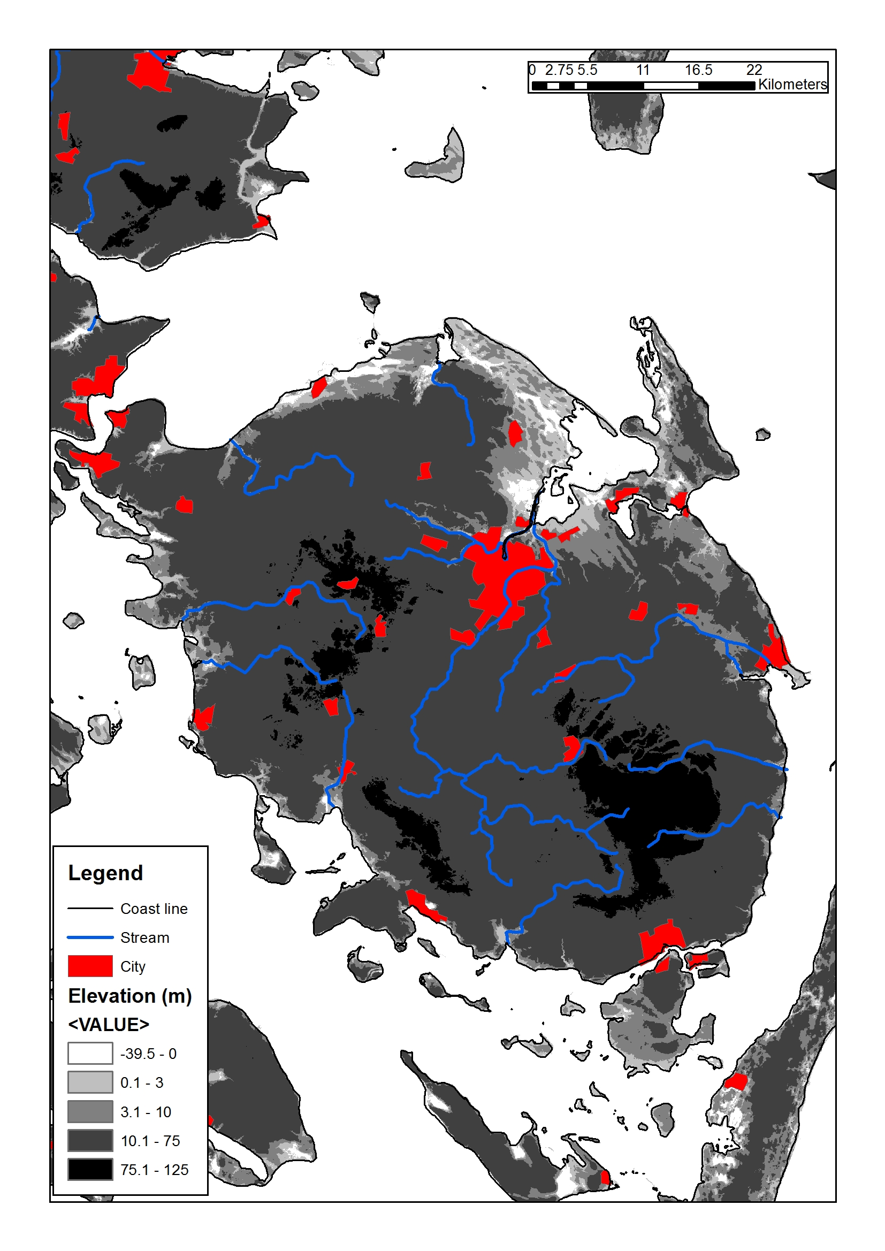
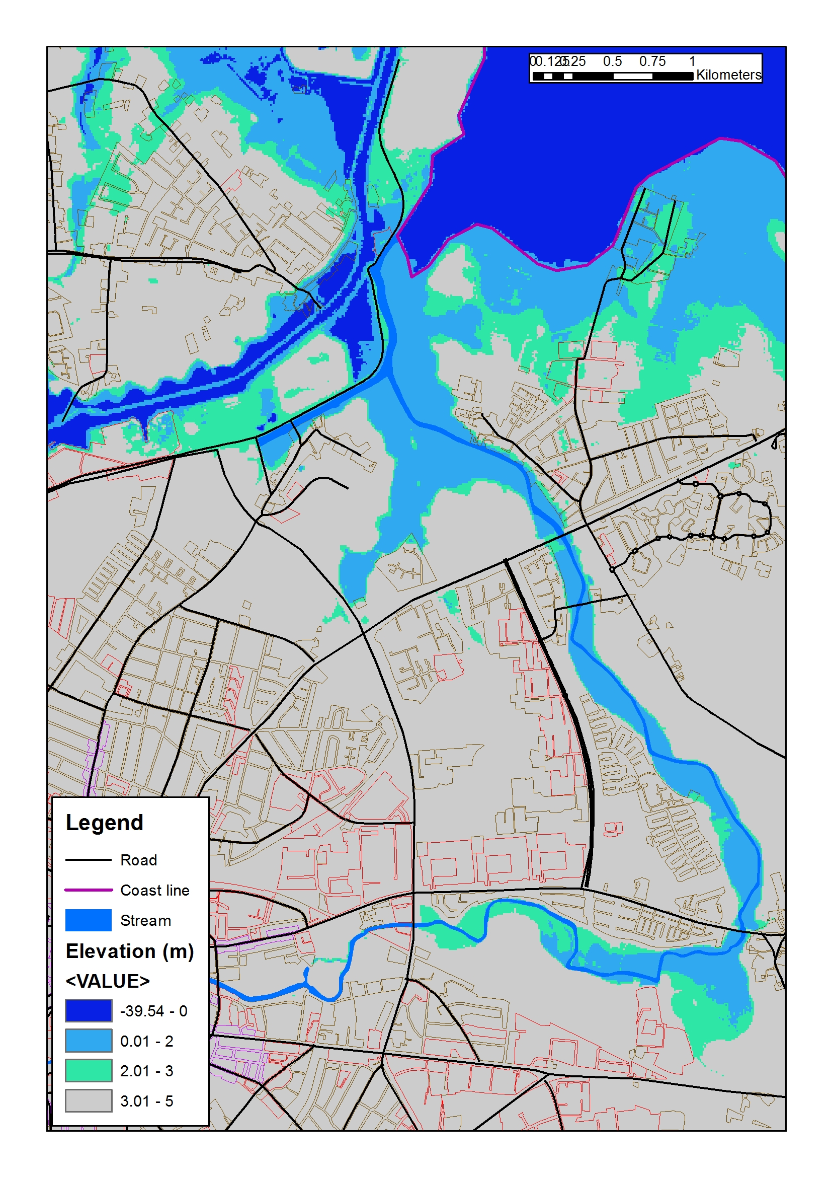
Case study: Odense
14

Slide 15
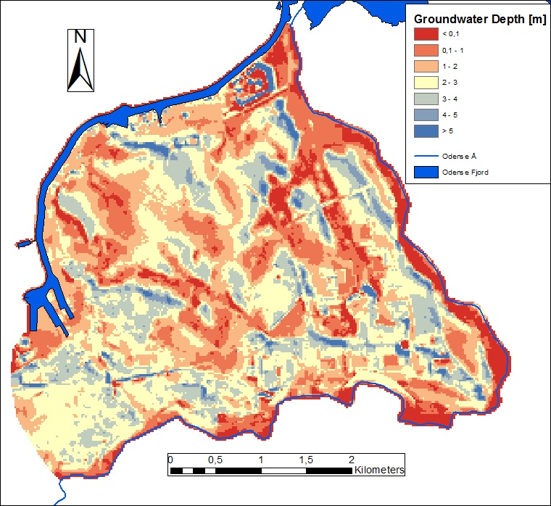
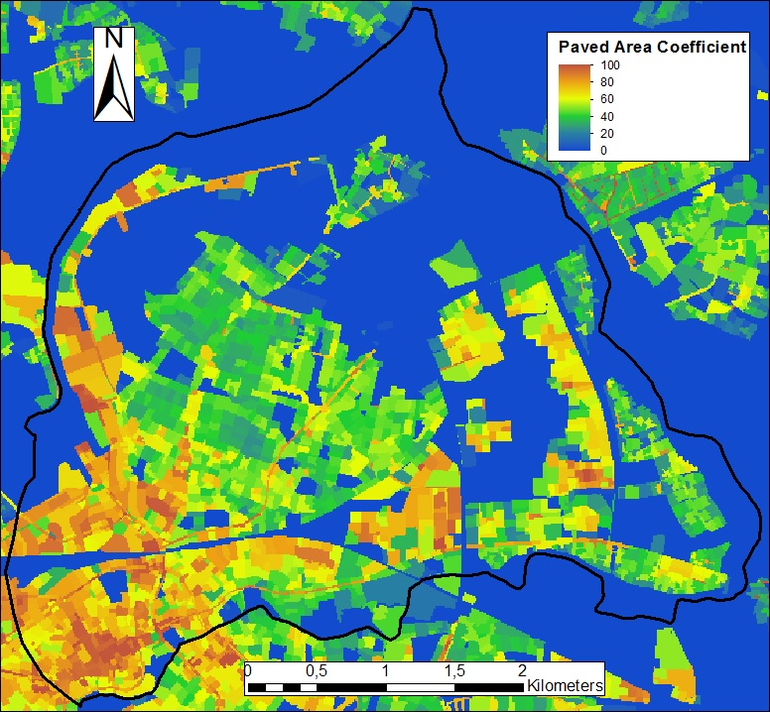
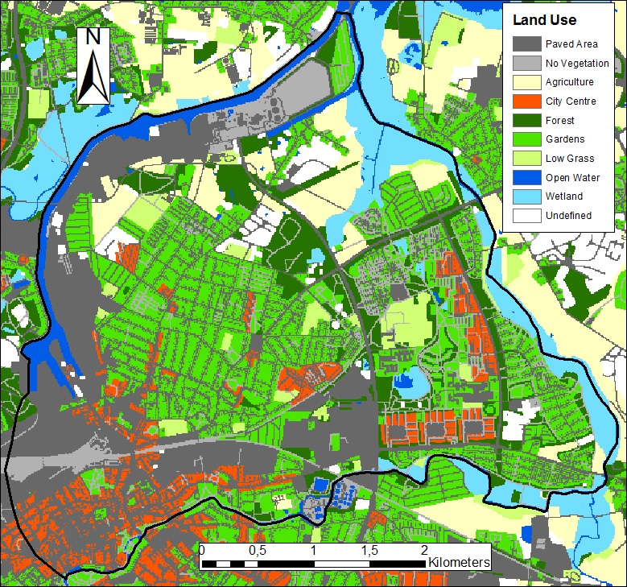
Development of groundwater and surface water flood risk assessment model for analysing urban climate change adaptation measures for Odense city centre and Skibhus area (Øyvind/CPH University-GEUS)
The study illustrated that forced infiltration of rain water from paved areas will lead to a severe increase of the groundwater level close to the infiltration basins.
The geology seem to make a large impact, and a high hydraulic conductivity is needed “to spread” the infiltrated water.
Rise of the groundwater level up to one meter modelled in Odense area due to increased winter precipitation, and increased sea level of a similar magnitude near is expected, and proper measures for combating these present and
future risks are required
Simulated depth to
shallow groundwater
level
Paved area
coefficient
Land use for model area
15

Slide 16
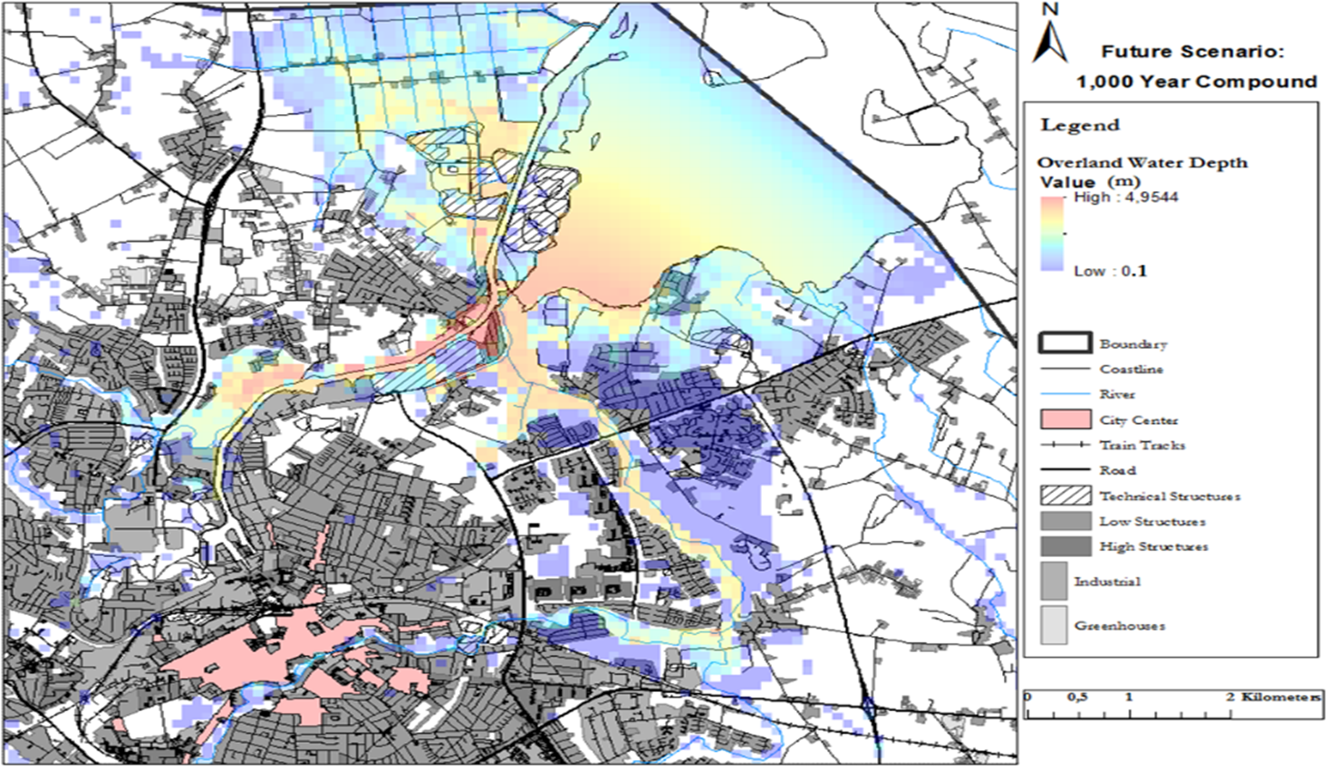
Analysis of time series data on water level in Odense fiord and river system in order to provide flooding risk assessment for concurrent events: storm surges and river flooding (Andrew/CPH University-GEUS)
The study has illustrated that without adaption to forecasted climatic condition the flood damages at Odense will increase from 3.9 MDKK in 2010 to 9.3 MDKK by year 2100
The study highlighted inundation potentially occurring at Odense in relation to concurrent events from storm surge and river flooding to damage costs of approximately 833 MDKK regarding public owned property at risk.
This amount does not include critical infrastructure damage costs or the potential interruption of commerce due to accessibility being interrupted.
Result of coincidence between a high runoff in Odense River and a high sea level in Odense Fiord.
The resulting flooding is primary observed along the downstream part of Odense River
16

Slide 17
Storm surge risk and sea level rise
Storm surges do cause damage in Iceland
The problem may become more acute with sea level rise
We focussed on three things
1. Estimating the current risk
2. Study likely changes to the risk in the future
3. Develop a coastal modelling system for warnings

Slide 18
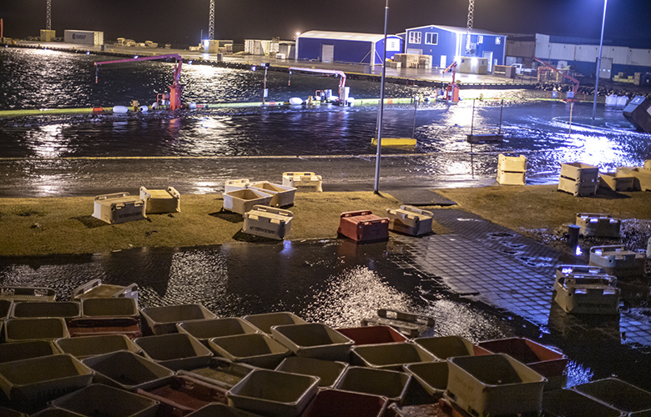
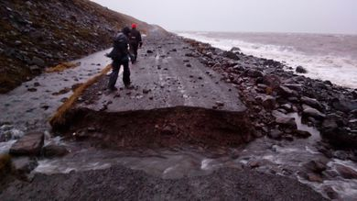
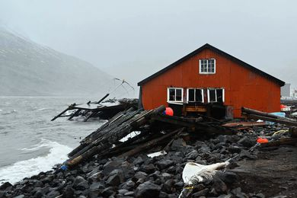
The current risks and future sea level rise
https://www.youtube.com/watch?v=_AL2wm82teA&feature=youtu.be
(visir.is)
(Grindavik.is)

Slide 19
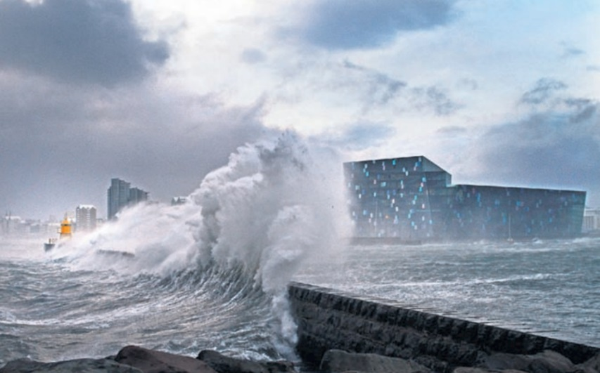
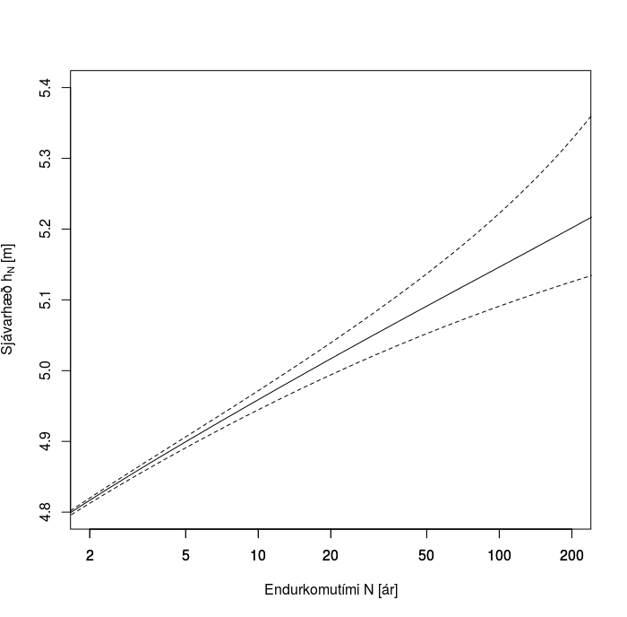
The current risks and future sea level rise
The current risk is best estimated using long term measurements of sea level
Unfortunately, such records only exist in one location in Iceland (Reykjavik).
Analyse that and develop methods to transfer the knowledge to other locations with shorter records.

Slide 20
The current risks and future sea level rise
Note that the difference between a flood with 1% annual likelihood (the 100 year flood) and a flood with 10% likelihood (a 10 year flood) is only 20 cm. ➔ Only a slight sea level rise can make bad floods much more frequent.
Similar results are likely to hold elsewhere in Iceland.
20 cm!
10 times more
frequent

Slide 21
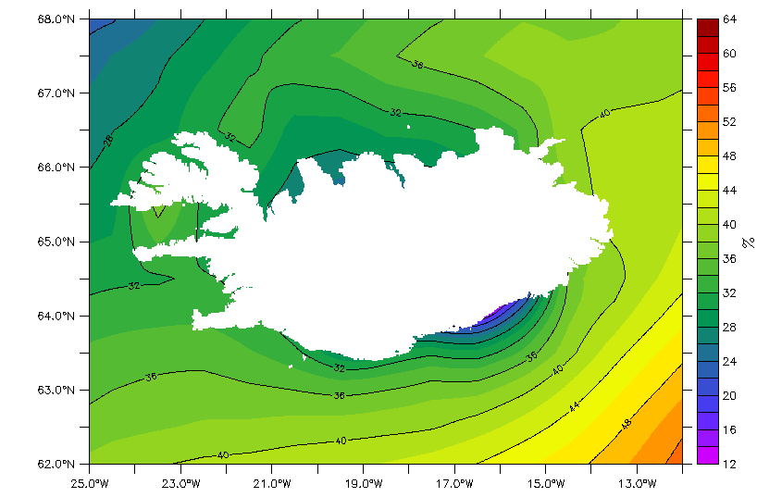
The current risks and future sea level rise
Sea level rise in Iceland is heavily influenced by changes in the gravitational field due to Greenland ice mass loss
Absolute sea level rise increase in Iceland is less than global
However, land uplift/subsidence is also very significant

Slide 22
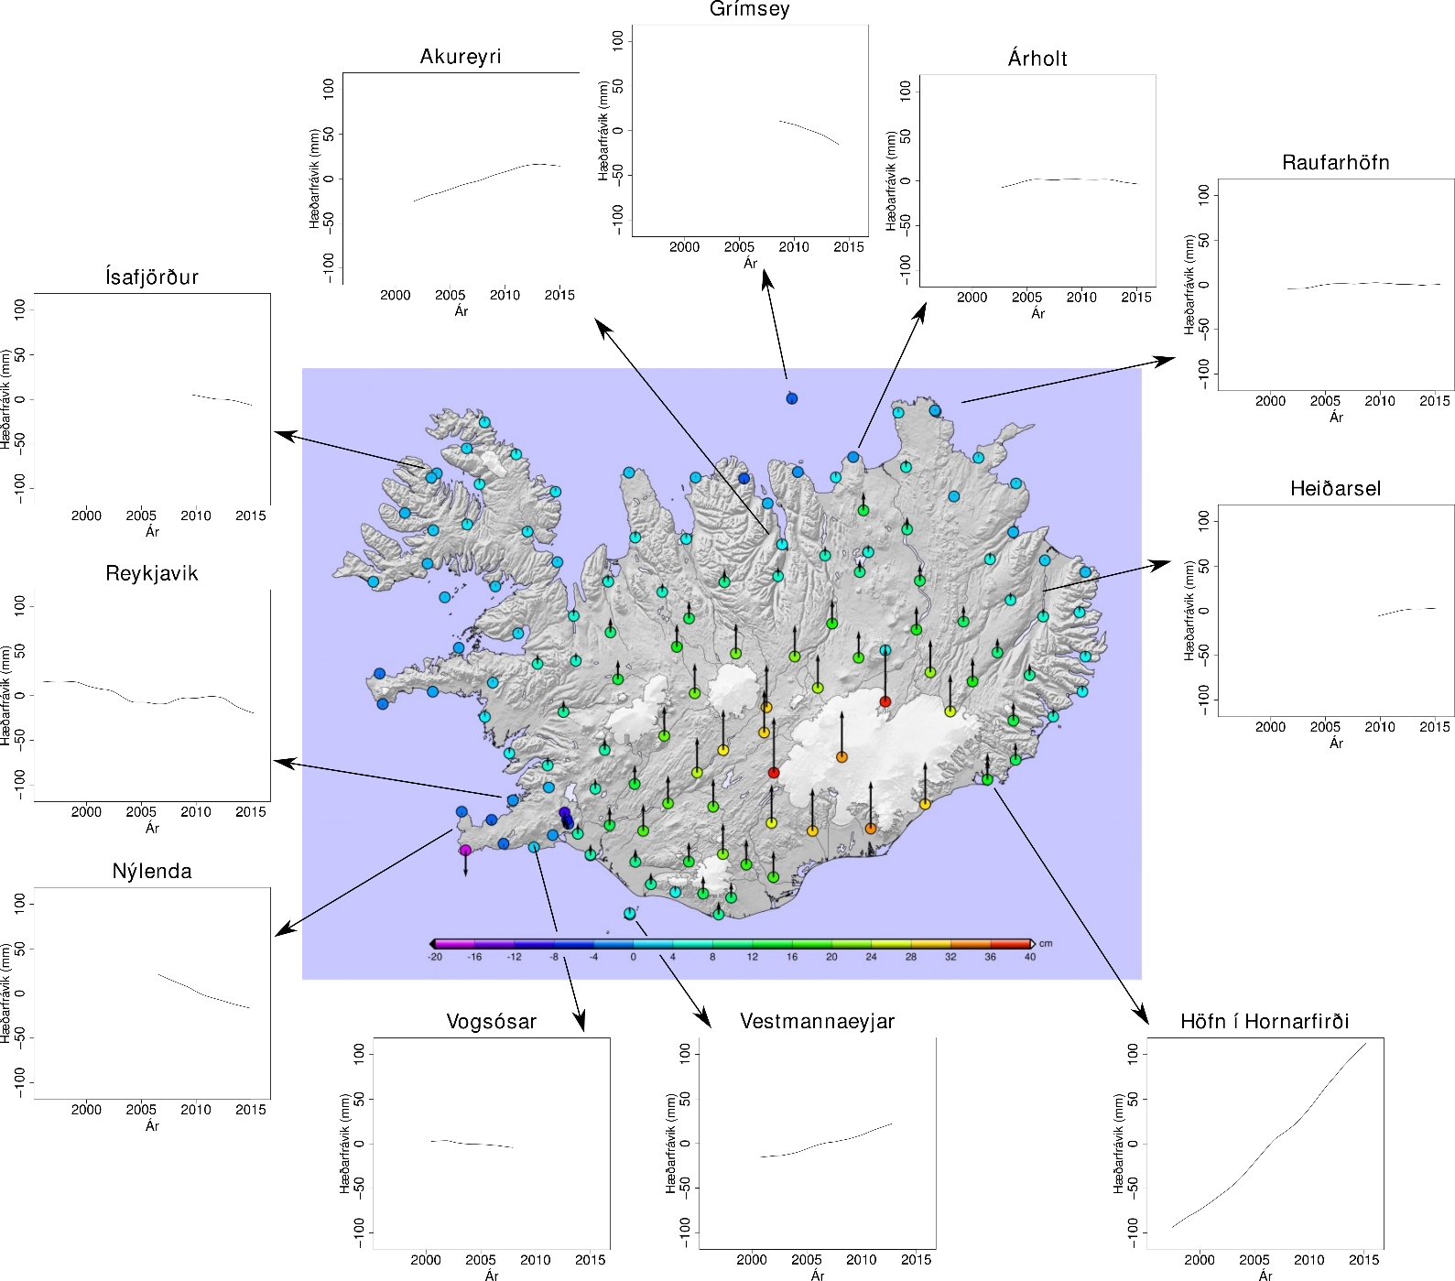
The current risks and future sea level rise
Uplift in Iceland at the coast is more than 1 m per century where it is fastest
Sea level drop likely
The heavily populated areas on the SW coast are subsiding
Sea level rise will be more acute there

Slide 23
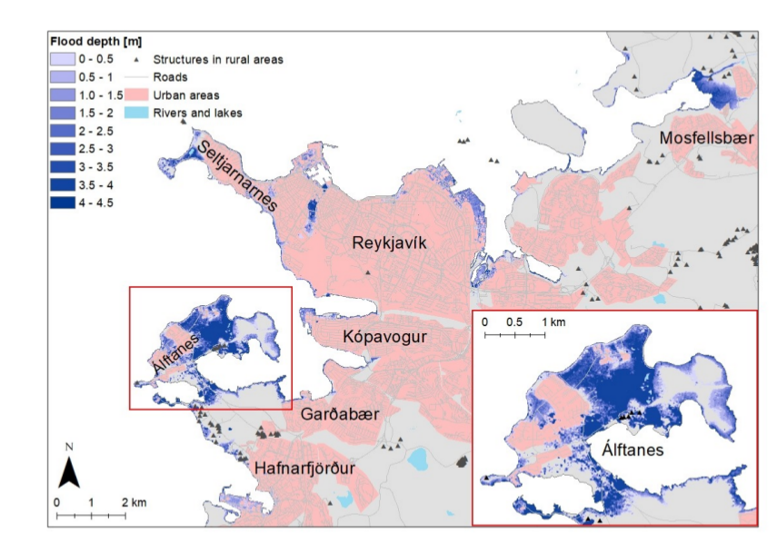
The current risks and future sea level rise
Adding information about sea level rise and height of storm highest floods makes it possible to estimate regions at risk
Preliminary work with an absolute worst case scenario

Slide 24
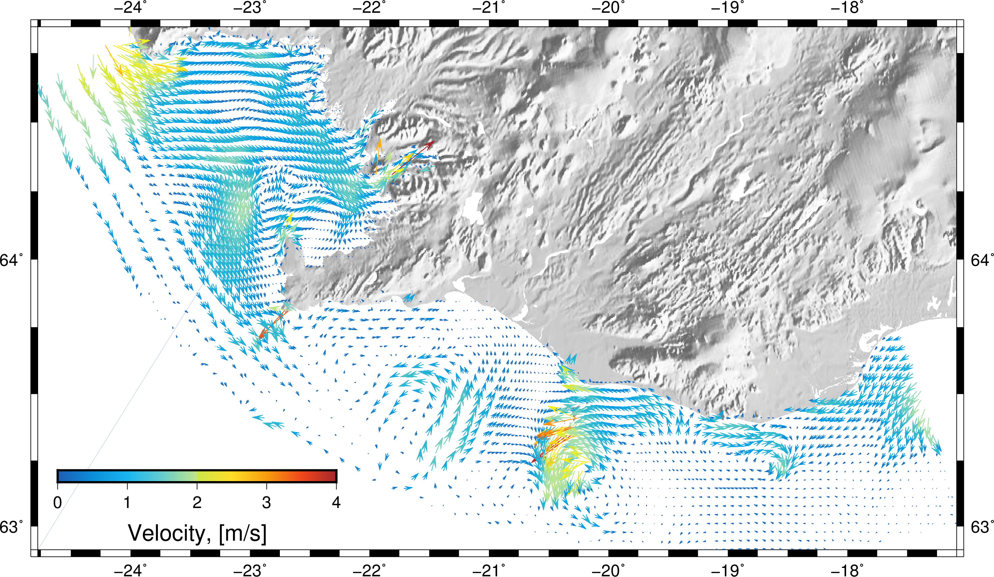
Monitoring,
modelling and
forecasting
Being able to estimate the
risk is just one step to
enhancing societal safety
Communicating
Modelling and forecasting is a very important part of the solution

Slide 25
Monitoring, modelling and forecasting
Building a model to reproduces historical events, aid with risk assessment and forecast future events
Identify flooding “hot spots” from past and future scenarios & map the risk in detail
Model is running and a pilot region should be operational next year

Slide 26
Monitoring, modelling and forecasting

Slide 27
Science and societal safety
In NORDRESS scientific results from academia have been used to assist the work in institutes that deal with infrastructure and societal safety
Knowledge makes it possible to use
data to estimate risk and build models and warning systems → Enhance societal safety
Data
Knowledge
Safety
Modelling & Warnings
Risk
assessment

Slide 28
Preparing for the future
NORDRESS related work continues in other projects to implement results found here and to answer new questions that have arisen during the project
CAMEL
Climate Adaptation by Managed Realignment
EVOKED - Communicatio of climate services using Living Labs

