Slide 1
Arctic Search and rescue
05/04 2019, version 1.2
A Learning and dialogue Game

Slide 2
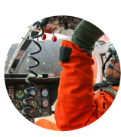
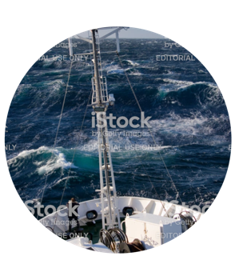
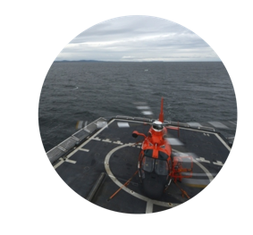
Background
Primary aim: To facilitate a dialogue on cross-boundary SAR between providers and receivers of SAR in the Arctic
Secondary aim: To create awareness of the importance and complexity of SAR in remote areas
Partners: Researchers from NORDRESS WP 5.4 ”Arctic Offshore Challenges” and Danish learning game developer Workz
Output: A research-based board game designed for educational purpose – but not professional training
Please note: All game illustrations included in this presentation are drafts and sketches of what the various components of a final Search-and-Rescue learning game might look like.

Slide 3
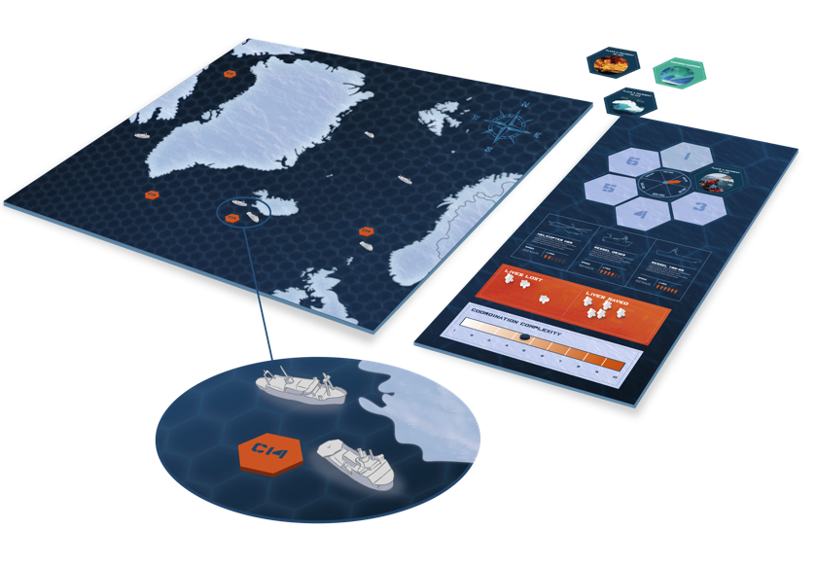
gameplay
Collaborative game concept: Players control all JRCCs in the area
Map: Hexagon grid (50 NM across)
Phases: 4 hours per turn
Units: SRUs
Large ships (HELO)
Small ships “HIFR)
Helicopters: Must finish operations in a single turn or refuel
Status board:
Time progress from distress signal
Number of people on units
Count of lives lost/lives saved
Complexity indicator

Slide 4
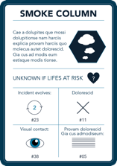
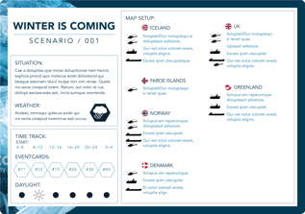
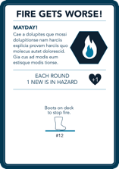
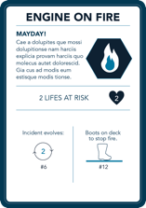
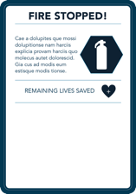
Scenarios
Scenario-based:
Pre-designed scenarios
User-designed scenarios (web-based editor)
Unpredictable factors (weather, current etc.)
Incident cards:
Inject events, provide information and new tasks
Increase or decrease complexity of the game
Present dilemmas (risk-taking)

Slide 5
Way ahead
Presentations of game concept have shown great interest from practitioners
Total costs of development is approx. DKK 600.000,-
Own funds approx. DKK 100.000,- Royal Danish Defence College, DKK 200.000,-, Remains approx. DKK 300.000,-
Development of prototype begins in December 2019.
Fundraising is ongoing

Slide 6
CONTACT
Morten Vendelø
Copenhagen Business School
mtv@cbs.dk
Rasmus Dahlberg
Royal Danish Defence College
rada@fak.dk

