Slide 1
WP 5.5 The Vulnerability of Air Traffic
to Volcanic Eruptions
Uta Reichardt
Environment and Natural Resources Program
Guðrún Pétursdóttir
Institute for Sustainability and Interdisciplinary Studies
Guðmundur Freyr Úlfarsson
Faculty of Civil and Environmental Engineering
University of Iceland
Source: Reichardt, 2018

Slide 2

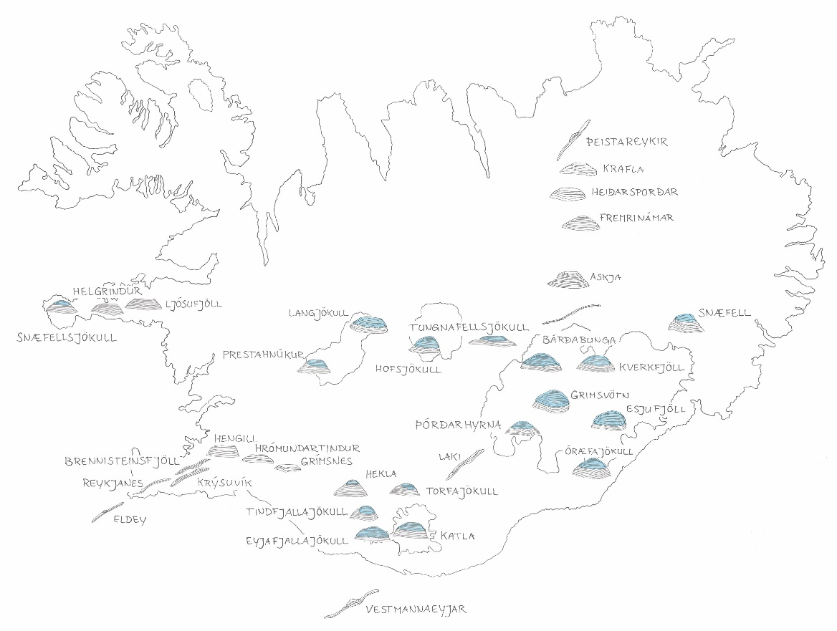
Active Volcanoes in Iceland
Source: Reichardt, 2018

Slide 3
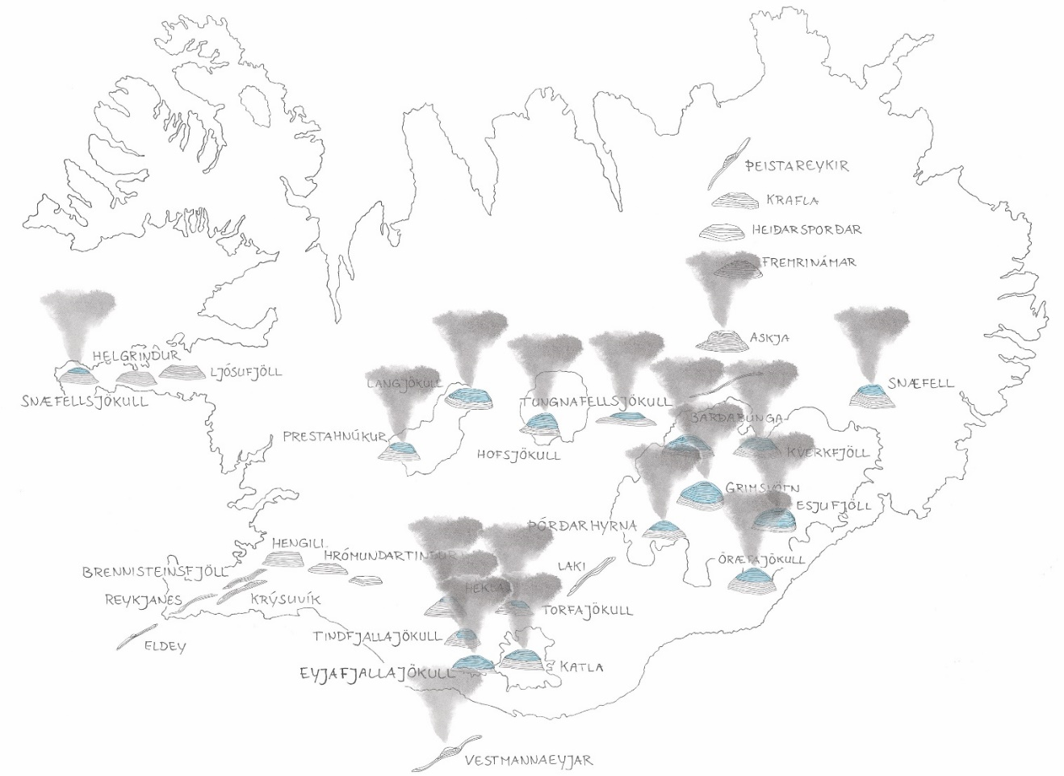
Active Volcanoes under Water Bodies
Source: Reichardt, 2018

Slide 4
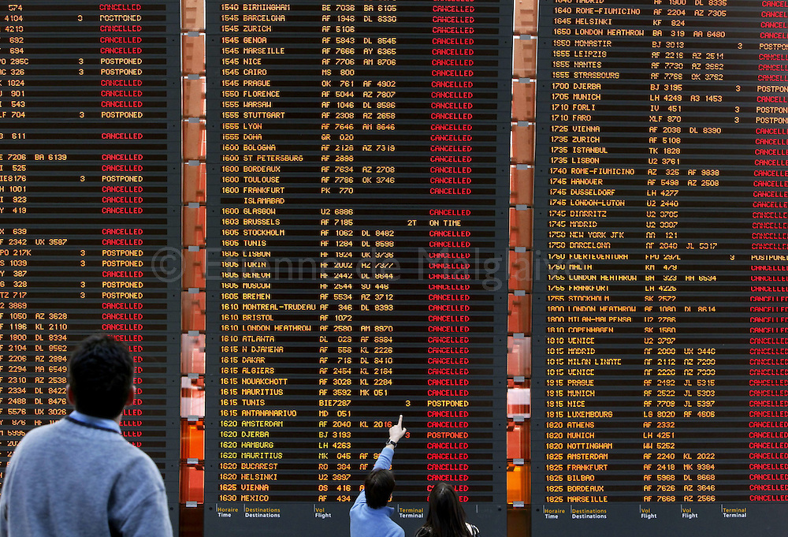
Eyjafjallajökull Eruption 2010
100,000 flights cancelled
10 million passengers affected
€ 3.75 billion financial loss
(Source: Etienne de Malglaive, 2010)

Slide 5
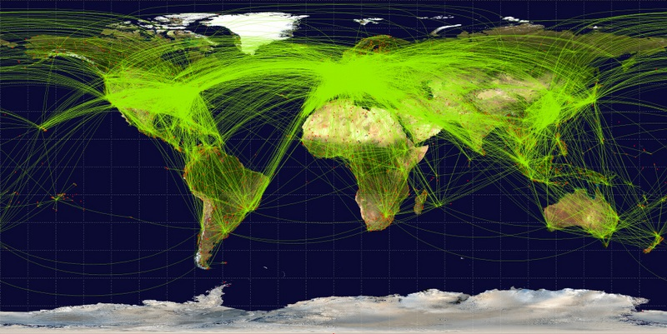
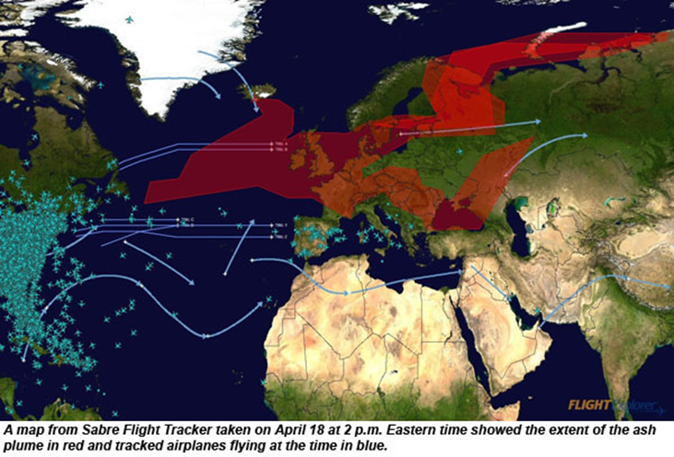
Air Traffic Corridors
Source: Jpatokal, 2009
Global air traffic and flight corridors
Flight disruption during April 2010
Source: BBC World News, 2009

Slide 6
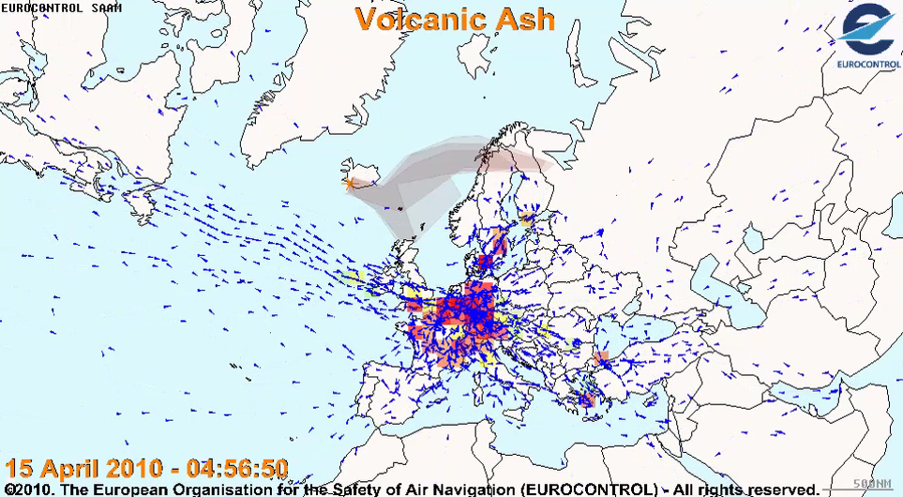
Animated Impact on Air Traffic
[Still of the animation, since file was to big for Email]

Slide 7
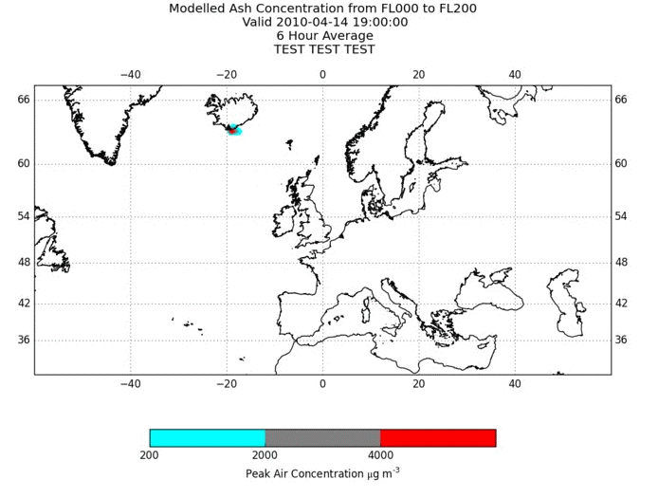
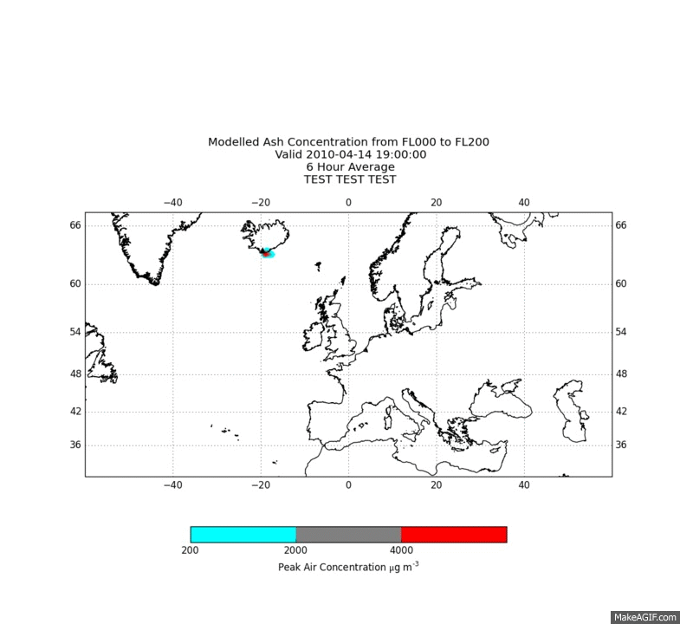
Eyjafjallajökull Scenario
Long duration event
Eyjafjallajökull scenario x 4 eruption time
Column height: 10 km
Total erupted volume: 1 km³
Aviation impact duration: 24 weeks
Broad band of low ash concentration
days into the eruption
Described in: Reichardt, U., G. F. Ulfarsson, and G. Pétursdóttir, 2018. Developing Scenarios to Explore Impacts and Weaknesses in Aviation Response Exercises for Volcanic Ash Eruptions. The 97th Annual Meeting of the Transportation Research Board. Compendium of Papers. Transportation Research Board, National Research Council, Washington, D.C., U.S.A., 16 pp.

Slide 8
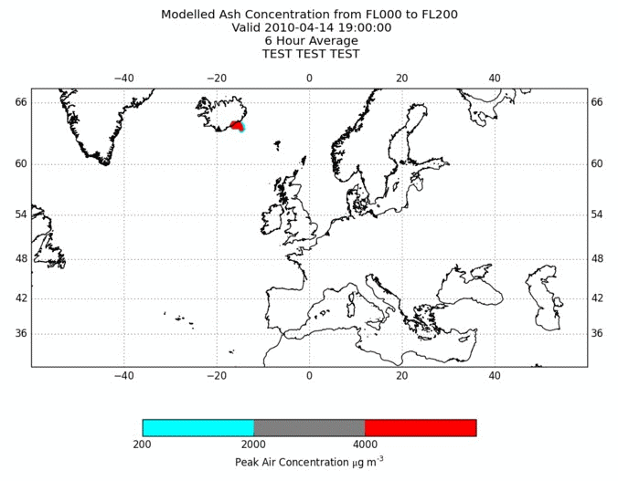

Öræfajökull Scenario
High intensity event
Öræfajökull scenario from 1362
Column height: 25 km
Total erupted volume: 10 km³
Aviation impact duration: 2 – 3 weeks
High ash concentrations prevailing over Europe
Described in: Reichardt, U., G. F. Ulfarsson, and G. Pétursdóttir, 2018. Developing Scenarios to Explore Impacts and Weaknesses in Aviation Response Exercises for Volcanic Ash Eruptions. The 97th Annual Meeting of the Transportation Research Board. Compendium of Papers. Transportation Research Board, National Research Council, Washington, D.C., U.S.A., 16 pp.

Slide 9
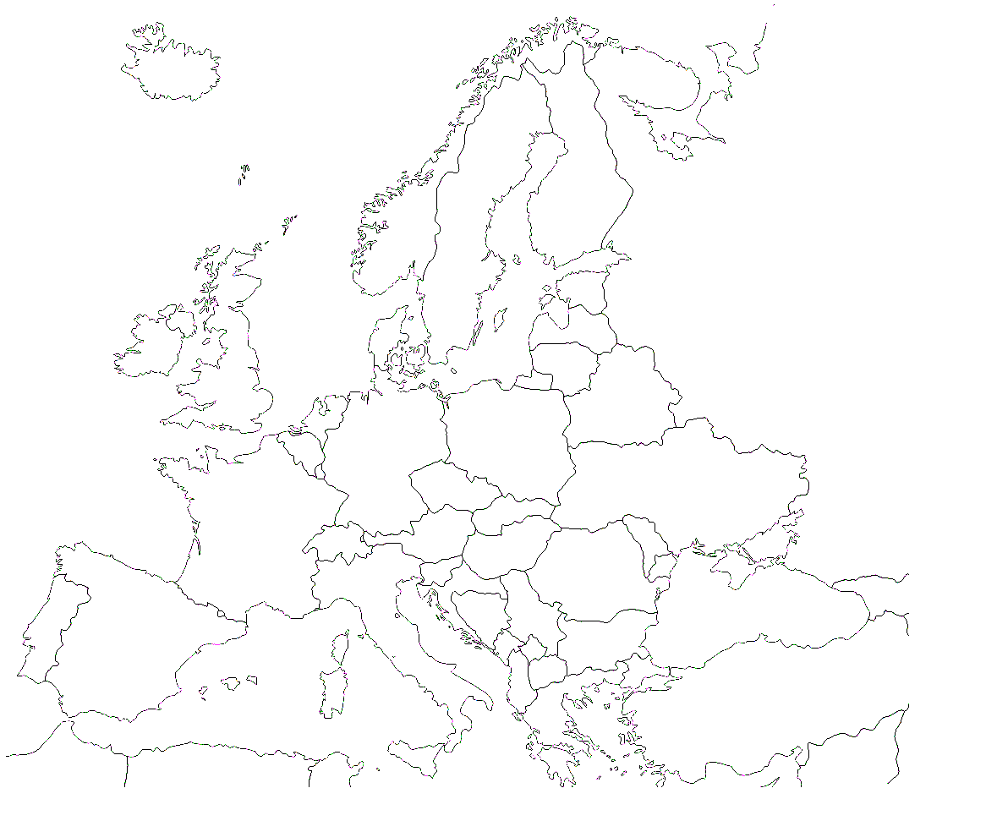

Stakeholders Interviewed
Icelandair
Icelandic Civil Aviation Authority
ISAVIA
Icelandic Meteorological Office
Regulators
Information provider
Service provider
Volcanic Ash Advisory
Centre London
Rolls Royce
Operators
EUROCONTROL
International Civil Aviation Organization
Map Source: Dalet, 2013

Slide 10
Scenario Evaluation
Eyjafjallajökull:
Affects air traffic at low altitudes, take-offs and landings
“Even under the new [EU] regulations, by day two, flights would be limited, approximately up to 50% – a significant reduction in air traffic.”
– Representative from Rolls Royce
Öræfajökull:
Impacts air traffic at all altitudes, including the four busiest European airports
“I do not believe that any aircraft operator would fly through areas of high ash concentration unless they are convinced that the ash concentration forecast is incorrect and their SRA [Safety Risk Assessment] allows them to operate in such areas.”
– Representative from Eurocontrol

Slide 11

Regulatory framework and instruments formally well established
The network needs to have a wider scope both in terms of possible partners and events
Scientists, manufacturers, regulators and operators need to share a platform
Essential to prepare broad-scale
overall contingency plans for
transportation if aircrafts are grounded

Slide 12
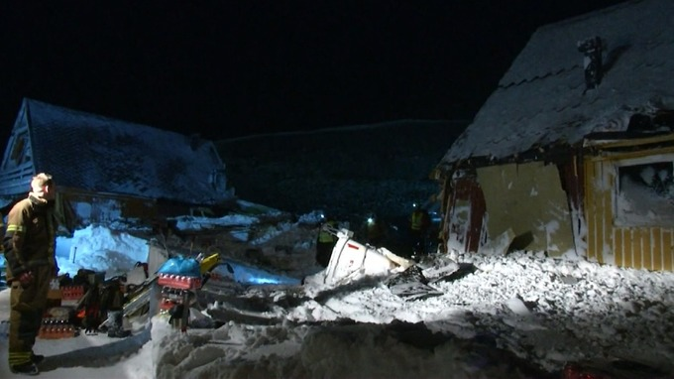
UAU124F
Coping with disasters

Slide 13
Contact: utar@hi.is | + 354 781 4290

